Slide 1

Intro to CSS
Introduction to Frontend Web Design

Slide 2
Agenda
House Keeping
HTML Review
CSS
Q&A

Slide 3
House Keeping
Code to get in the front door is 9596*
Please make sure you fill out the form Kristen sent
My number is 440-364-0471, please text if anything goes wrong getting in

Slide 4
HTML in Review

Slide 5
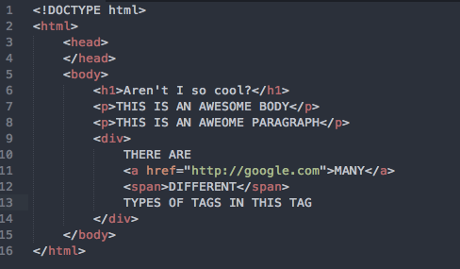
The Document
Notes:
Let’s review HTML a bit:
As you recall HTML documents start with a DOCTYPE, then a pair of html tags, followed by a head and a body.
Tags are the majority of an html document. They are what gives the document the structure and skeleton of a web page. They come in pairs except for several exceptions.

Slide 6
Attributes
<a href=“http://google.com” id=“foo-bar” class=“eggs bacon” target=“_blank” title=“Meta content goes here”>Content goes in here</a>
Notes:
Tags can have attributes. These attributes define more things about said tags.

Slide 7
Browsers Create DOM from HTML
Notes:
When a browser displays or renders a web page for viewing, it creates a document object model, or DOM. I said it wasn’t important the details just that it did it. So why is it important that it does it?

Slide 8
CSS: The Basics
Notes:
It’s important because today we talk about CSS. Now what is CSS?

Slide 9
History of CSS
Stands for cascading style sheets
Style sheets were added to HTML in 95
CSS was invented in 96
Added to HTML 4 officially
Intended to solve a specific problem
Notes:
CSS stands for cascading style sheets. As you may recall in our little overview over html, Style sheets were added to HTML in 95. They were added to HTML4 as an official part of the spec. Their purpose was to solve a problem.

Slide 10


<font/> <b/> <center/>
Notes:
Here’s a font tag in HTML. It’s icky. Think of it like a spider. Why? Because it confuses display code with layout code. While this distinction may seem absurd, trust me when I say it makes a big big difference when you’re editing a page. It’s creating a convoluted and complicated document when the document could be much simpler. And HTML is littered with these types of tags and most are still supported by browsers. So how is CSS placed on a web page?

Slide 11
How to use CSS
<div font=“14”>Content</div>
<div style=“font-size: 14px;”>Content</div>
Separate file
Notes:
Well you can use them as attributes. This is bad.
You can use them as inline styles. This is still bad but sometimes necessary.
You can place them in their own separate file. This is the best practice
CSS comes in rules. What do these rules look like?

Slide 12
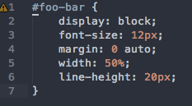
Notes:
You’ll notice that several parts of this rule. The part before the braces are called selectors, and the most complicated part of css. We’ll talk more in-depth about these things. Next you’ll notice that inside the braces that rules again come in key value pairs. Similar to attributes. Only now the keys are followed by colons followed by values. You can look these keys up on the internet. There are a lot of them but it’s a static set. What this block of code is doing is applying all the rules inside the braces to the selected elements

Slide 13
* = everything
Notes:
Let’s talk a bit more about selectors. Remember how we said the DOM is important? Well it’s important because selectors are capable of selecting certain nodes in the tree. For example let’s look at this syntax. * is a wildcard. It means select everything.

Slide 14
div = all div tags
Notes:
An element selector is just the name of a tag. For example this just says select every div.

Slide 15
div, a = all divs and all anchors
Notes:
If you want to select multiple different things to apply the same style to, you can separate the rules with commas.

Slide 16
#foo-bar = element with id foo-bar
Notes:
Now let’s talk about some of the more important selectors. Remember ids? This is how you select a node with an id.

Slide 17
.eggs = all elements with eggs class
Notes:
You can also select a class like this.

Slide 18
div#foo-bar.eggs, a#foo-bar.eggs = div with id foo-bar and class eggs
Notes:
You can also select all elements of a certain class or id or both. Or you can select an id with a class. Or an element with a class. The possibilities are endless

Slide 19
#foo-bar, #foo-bar .eggs = descendants of id foo-bar with class eggs
Notes:
Onto some more complicated selectors. This selector is any descendant. Now again if you recall a DOM is a tree structure. This means that this selector finds all descendants of the class with the second class attached and applies rules to them.

Slide 20
#foo-bar > .eggs = direct descendants of id foo-bar with class eggs
Notes:
This selector is direct descendants only (or children)

Slide 21
#foo-bar + .eggs = adjacent nodes to id foo-bar with class eggs
Notes:
This selector is applies rules to adjacent nodes. Now off the top of my head this one isn’t as widely supported (I believe ie8 does and below does not).

Slide 22
And Many more: http://code.tutsplus.com/tutorials/the-30-css-selectors-you-must-memorize--net-16048 http://css-tricks.com/child-and-sibling-selectors/
Notes:
And many many more. The ones above are the ones you’ll run into the most. But you should take a look at some of these. Now let’s do some exercises

Slide 23
Q&A

